Slide 1



?
P
o
e
o
K M N

Slide 2

?
PIKACHU
P
o
e
o
K M N

Slide 3
?
P
o
e
o
K M N

Slide 4
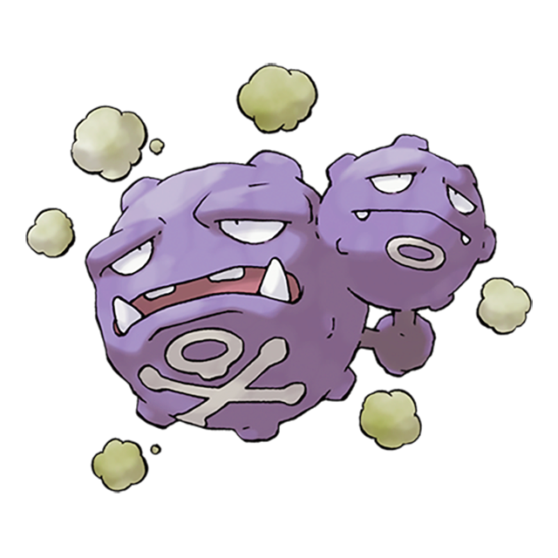
?
KOFFING
P
o
e
o
K M N

Slide 5
?
P
o
e
o
K M N

Slide 6

?
BULBASAUR
P
o
e
o
K M N

Slide 7
?
P
o
e
o
K M N

Slide 8

?
CHARMANDER
P
o
e
o
K M N

Slide 9
?
P
o
e
o
K M N

Slide 10

?
PSYDUCK
P
o
e
o
K M N

Slide 11
EXTRA RESOURCES

Slide 12

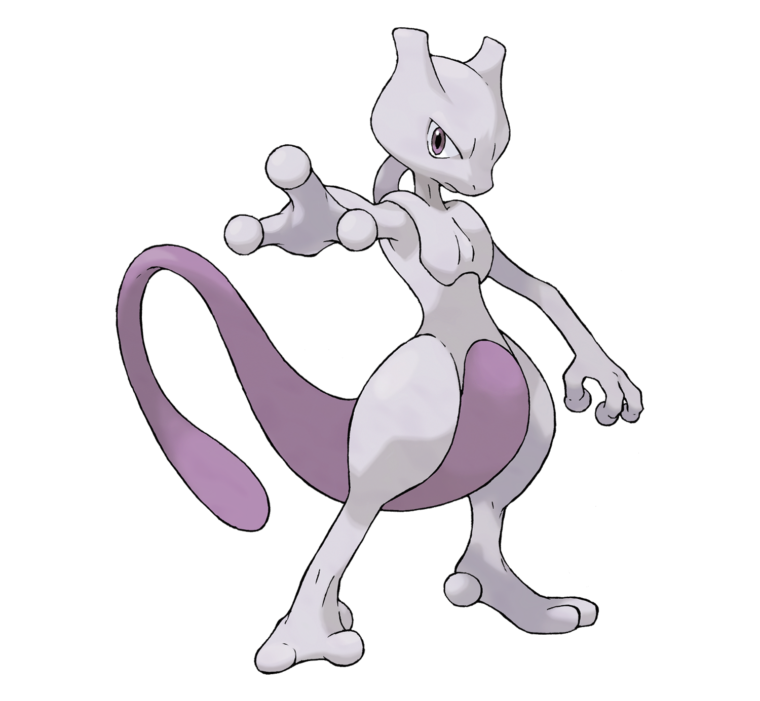


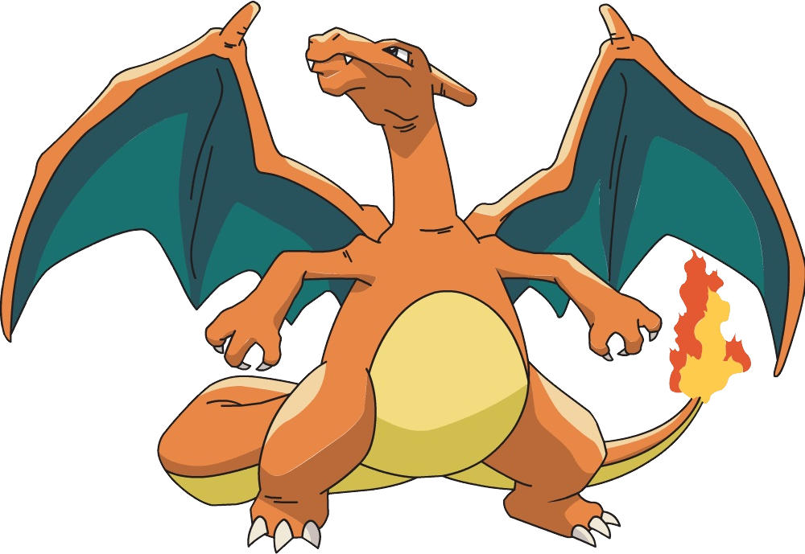





EXTRA RESOURCES

Slide 13
INSTRUCTIONS FOR USE
You must credit Slidechef in order to use this template
What you are allowed to do :
Modify this template
Use it for personal or commercial projects
What you are not allowed to do :
Offer Slidechef templates for download
Sublicense, sell or rent any Slidechef content
Distribute Slidechef content unless it has been authorized
Include Slidechef content in an online or offline file
Acquire the copyright of Slidechef content

Slide 14

Slide Chef

